Slide 1
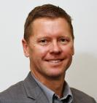
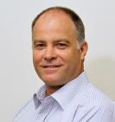
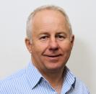
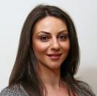
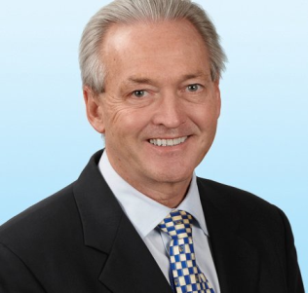
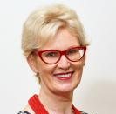
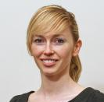
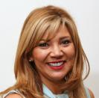
CoreNet Global Australia Chapter Committee - 2015
Simon Sherwood
Joint Chair
Tony Wyllie
Joint Chair
JLL
Kim Clarkson
Membership Leader
Lend Lease
Helen Savvides
Program Leader
Harris Mackay
Doug Henry
Sponsorship Leader
Colliers
Helen Rossi
Symposium Leader
Da Vinci on Sanders
Charlee Sharples
Young Leader
Brookfield Johnson Controls
Maria Russo-Fama Logistics Leader
Trinity Quality Interiors

Slide 2
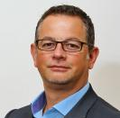
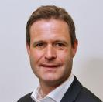
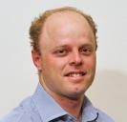
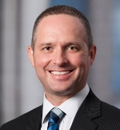
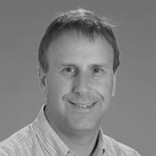
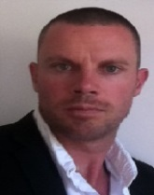
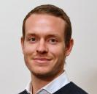
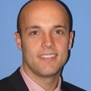
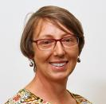
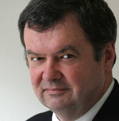
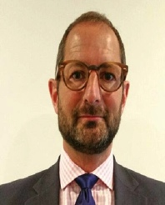
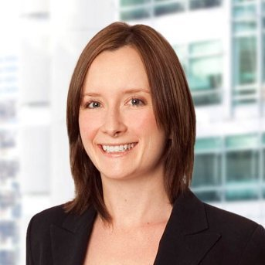
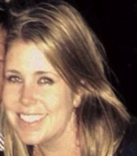
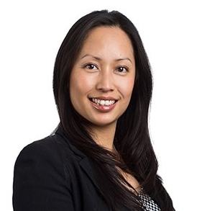
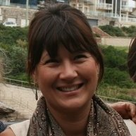
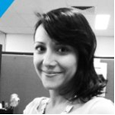
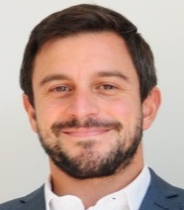
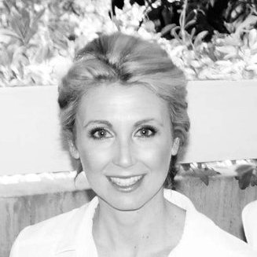
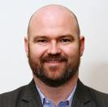
CoreNet Global Australia Chapter Sub-Committee Members - 2015
Membership Sub-Committee
Program Sub-Committee
Sponsorship Sub-Committee
Symposium Sub-Committee
Young Leaders Sub-Committee
Robert Tigani Schiavello
Richard Gee Brookfield GIS
Brad Summerson Cushman & Wakefield
Gary Finnegan Savills
Chris Heywood Melbourne Uni
Andrew Blake Intermain
Jackson King JLL
Andrew Peak CBRE
Alison Terry Geyer
Chris Alcock Workspace Logic
Danny Green Cushman & Wakefield
Lauren Day
JLL
Bernadette Holloway
Zurich Fin Services
Sue Nheiu
Brookfield GIS
Tanya Lim
DEXUS
Jonathan Green M Moser Associates
Renee Bengston
Property Beyond
Christeneh Avaness Commscope
Albert Eichholzer Grosvenor Mgmt Consulting

